Slide 1
CUSTOMER DATA ANALYSIS
Shopping, Sales & Payment Analysis
Data Analytics Project | SQL + Power BI
Submitted by: Yekabote Nanditha

Slide 2
1. Project Introduction
• Analyses customer shopping behavior using transactional data from multiple shopping malls.
• Examines customer demographics, product categories, purchasing quantity, revenue and payment methods.
• SQL is used for data extraction and analysis, while Power BI is used for interactive visualization.
• The objective is to identify customer patterns and support better business decisions.

Slide 3
2. Dataset Description
• Customer shopping transaction data collected from multiple shopping malls.
• Key attributes include invoice_no, customer_id, gender, age, category, quantity, price, payment_method, invoice_date and shopping_mall.
• The dataset supports analysis of customer demographics, purchasing behaviour, product demand, revenue and payment preferences.

Slide 4
3. Tools & Methodology
• MySQL: database connection, data exploration and SQL-based analysis.
• SQL: grouped and aggregated transactions by gender, age group, category and payment method.
• Revenue was calculated using quantity × price for each transaction.
• Power BI: KPI cards, slicers and charts were created to present the results interactively.

Slide 5
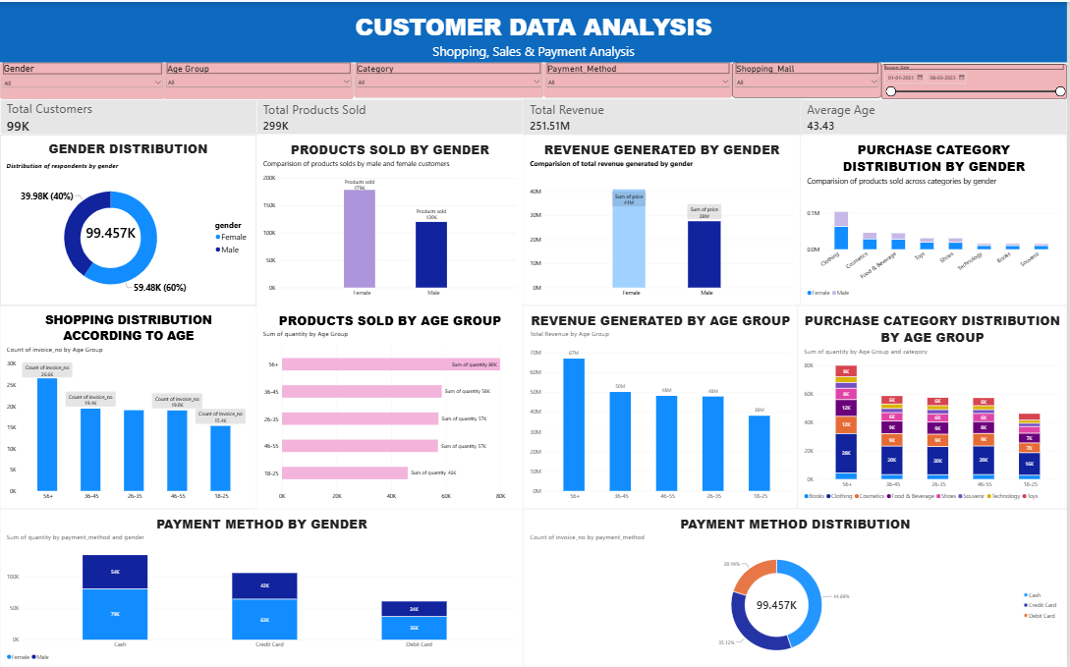
4. Power BI Dashboard
Customer, sales and payment analysis

Slide 6
5. Dashboard KPI Summary
• These KPIs provide high-level view of customer volume, products sold, revenue and average customer age.
Total Customers
Total Products Sold
Total Revenue
Average Age
99K
299K
251.51M
43.43

Slide 7
6. Key Insights
• Female customers account for about 60% of shopping transactions and contribute higher product sales and revenue than male customers.
• Shopping behaviour varies across age groups, with strong purchasing activity visible among older customers.
• The 56+ age group shows the strongest product-purchase and revenue contribution in the current dashboard.
• Clothing is the highest-volume purchase category, while category demand varies across customer segments.
• Payment-method usage varies across customer segments, providing useful information for customer targeting.

Slide 8
7. Business Recommendations
• Create targeted offers and loyalty programs for high-value female customers.
• Develop age-specific promotions and product recommendations for strong revenue-generating segments.
• Maintain sufficient inventory for high-demand categories such as Clothing.
• Use gender and age patterns to personalize marketing campaigns.
• Support multiple payment methods and test payment-specific incentives.
• Use the Power BI dashboard regularly to monitor customer behaviour and sales.

Slide 9
8. Conclusion
• The project converts customer transaction data into practical business insights.
• SQL helped analyse the data, while Power BI made the results easy to understand through interactive visuals.
• The analysis identifies important customer segments, product preferences, revenue patterns and payment behaviour.
• These insights can help improve marketing, inventory planning, customer engagement and revenue.

Slide 10
THANK YOU
Customer Data Analysis | SQL + Power BI

